Slide 1
Populations genetics and speciation
CH 17

Slide 2
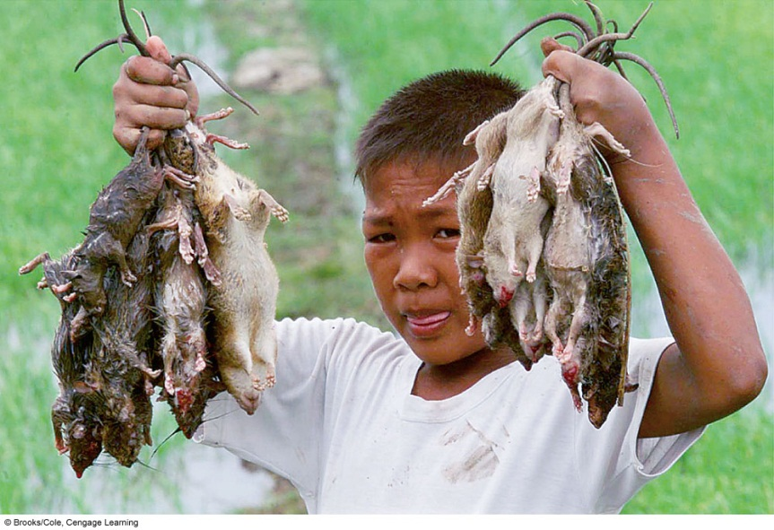
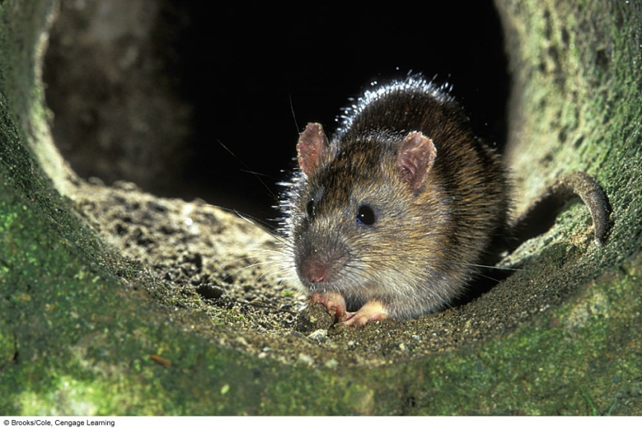
Impacts, Issues
Rise of the Super Rats
Example.
Your village is infested with rats.
Rats carry & spread disease and destroy crops.
You know a poison (Warfarin) that can kill rats.
What do you do?
Give the poison?
Leave them alone?
Figure out some other method?
Notes:
When warfarin was used to control rats, natural selection favored individuals with a mutation for warfarin resistance –
The result was a population of rats that couldn’t be killed with poison.
Now warfarin is rarely used or effective.

Slide 3
Poison: Warfarin
Most Killed By Warfarin
10% Survived… Why?
Resistance
Immunity
The MOST FIT

Slide 4
Antibiotic Resistant Bacteria
New Population
Resistant to Warfarin
Rats killed by Warfarin
Left to FOUND new population

Slide 5
How variation arises from similarities…
This is a real-life scenario that has happened in SE Asia.
Now the area is infested with rats… that are immune to warfarin
What the rat example illustrates is a concept that turns up again and again in nature and provides proof of evolution.
Evolving populations contain the traits necessary to survive within the variation when the environment turns on them.
Which traits will be good or more common normally can’t be predicted but through variation populations can survive and evolve.

Slide 6
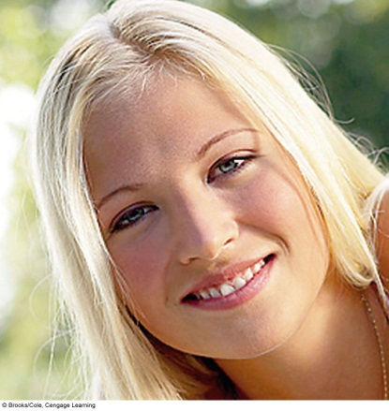


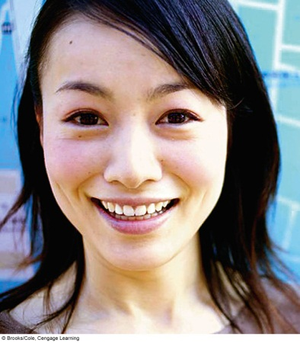
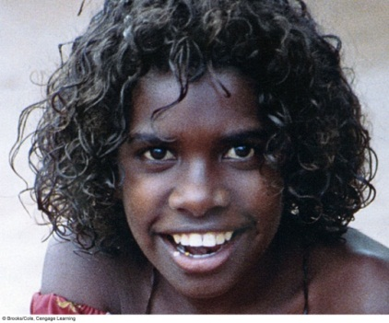

Variation In Populations
Population
  Interbreeding individuals of the same species in the same area.
All individuals of a species have to share certain traits
But individuals of a population vary in the details of these shared traits.
These variations of course are because of alternative versions of the alleles that cause these shared traits.
We study populations in evolution because individuals don’t evolve, populations do.

Slide 7
Objectives: Population Genetics
Part I
Restate how evolution is proven.
Restate how genetic variation and change is measured.
Identify what microevolution is.
Identify how microevolution is studied.
Relate phenotypic variation to microevolution.
List and explain how genetic variation originates.
Explain the affect of population size on genetic drift.
Identify the patterns of natural selection.
Part II
Determine how new species are formed.
Define “reproductive isolation” and determine mechanisms that cause it.
Restate what extinction is defined as.

Slide 8
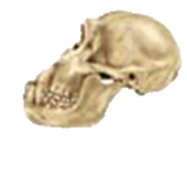
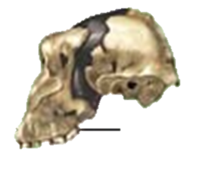
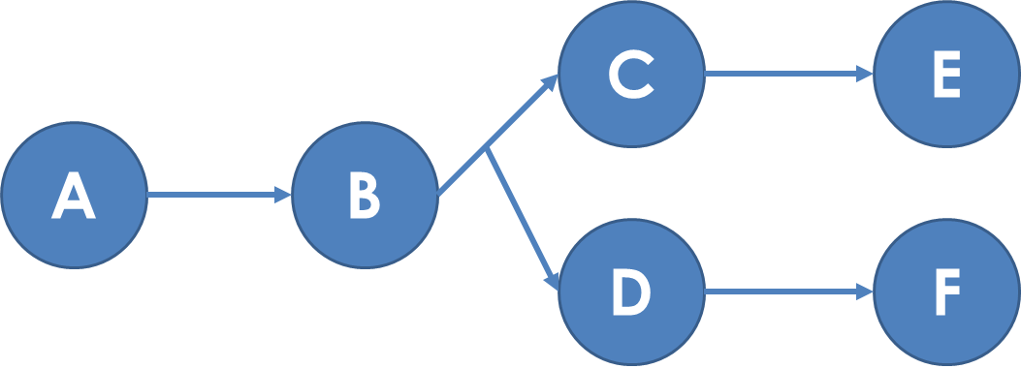
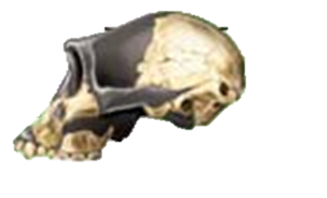
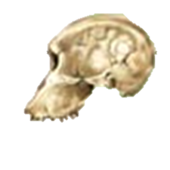
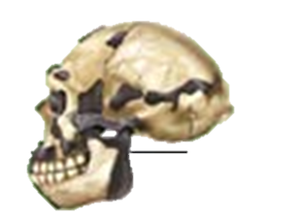
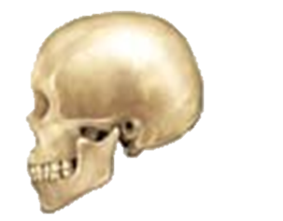
How do new species form & evolve?
Paranthropus boisei
Pan troglodytes
Australopithecus aferensis
Australopithecus africanus
Each letter represents a new species.
How are each formed?
Homo erectus
Homo sapiens

Slide 9
How do new species form & evolve
There are four “tenets” that need to be in place first:
Variation
Heredity
Overproduction
Selection caused by competition

Slide 10
How do new species form & evolve
There are two phases:
2. Macroevolution:
How new species form when they are isolated.
Microevolution:
How a species evolves on a genetic level.

Slide 11
I. Microevolution
Microevolution is the gradual increase of advantageous traits (ADAPTATIONS) within a population over generations.
It causes one species to evolve into another over time.

Slide 12
Microevolution
Forces of genetic change
Microevolution is shown by identifying changes in the % of individuals showing traits in a population.
There are 5 ways % of individuals showing traits changes.
These allow an organisms to evolve from A → B
Gene Flow
Genetic Drift
Mutation
Non-random Mating
Natural Selection

Slide 13
1. Gene Flow
Gene flow
  Physical movement of alleles caused by individuals moving into and away from populations
    Immigration, emigration, etc.
  Example#1: If an acorn is brought into a forest by a bird.
  Example #2: If an individual immigrates into another population from somewhere else, bringing new alleles into the gene pool.

Slide 14
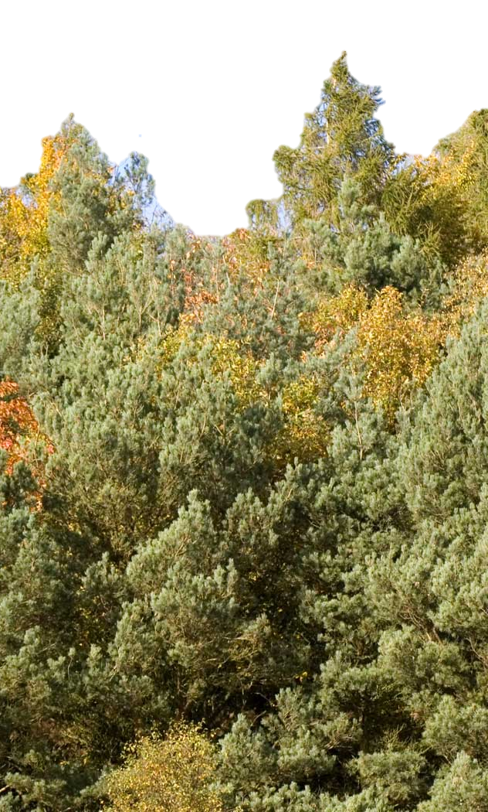
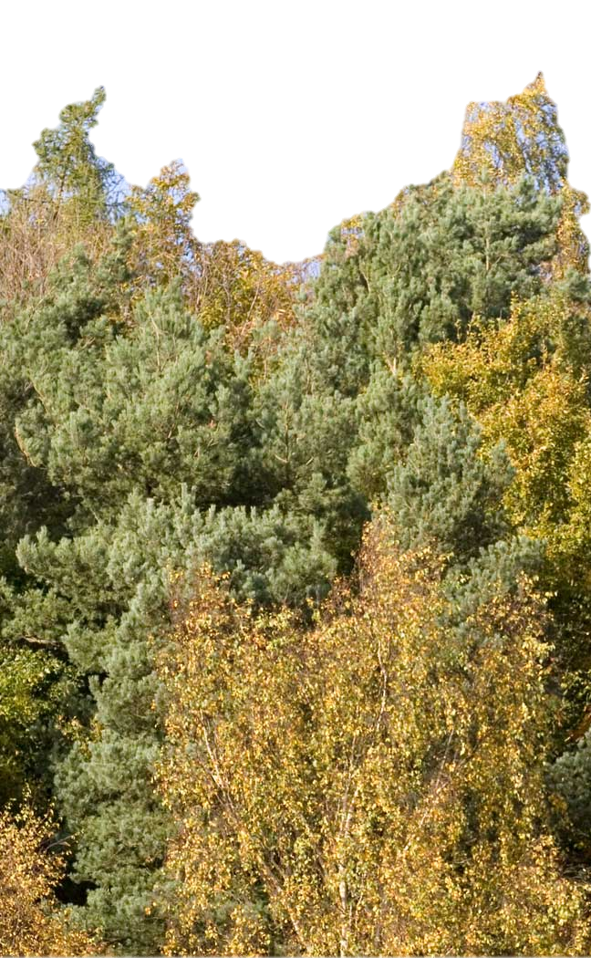
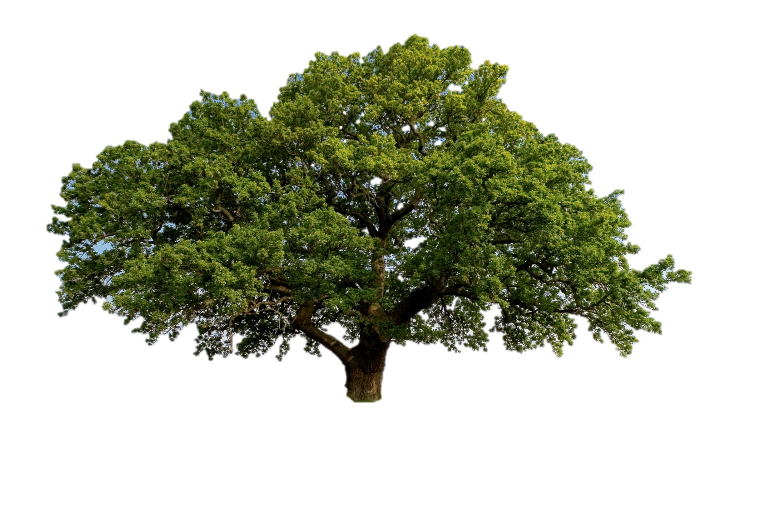
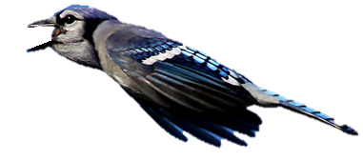

Gene Flow Between Oak Populations
Alleles carried in the acorn go from one part of the forest to another by vectors, such as birds or the wind.

Slide 15
2. Genetic Drift—
The Chance Changes
Genetic drift
  The random drifting of allele frequencies due to natural population interactions.
  Very much dependent on population size
  Think of your turtles…
    As the numbers of one variant increase so does the odds that this variant will keep reproducing as the others fall away over time.

Slide 16
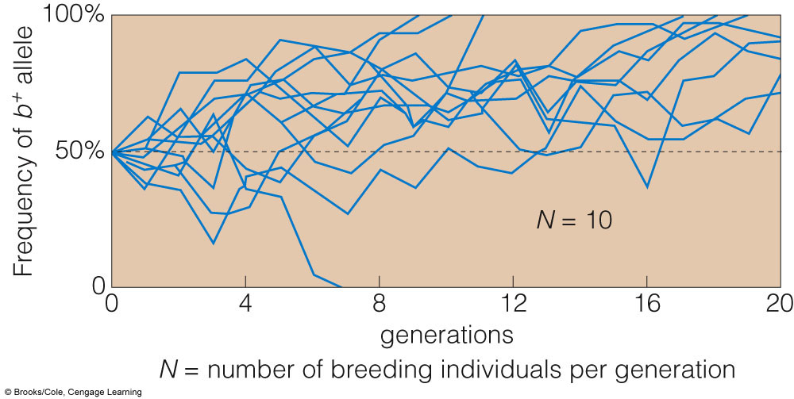
Genetic Drift and small Population Size
This graph shows how small populations change their phenotypes over several generations.
Each line represents a different population.
Notice how many different outcomes are possible.
Lots of change…

Slide 17
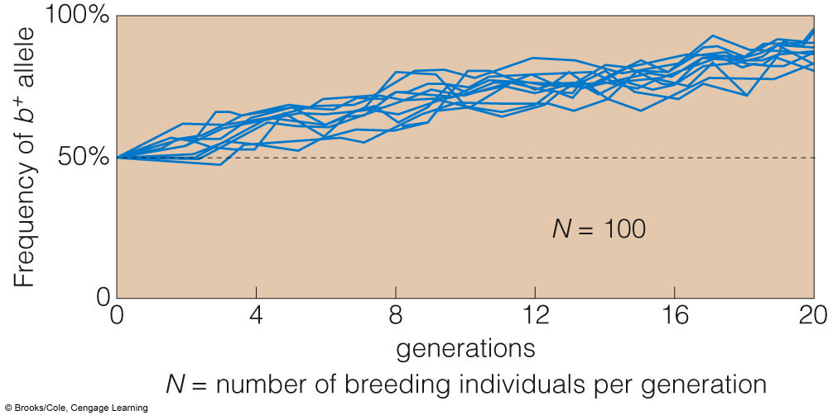
Genetic Drift and large Population Size
This graph shows how large populations are much more stable over several generations.
Each line represents a different population.
Notice how there are much fewer different outcomes possible.
Not as much change.

Slide 18
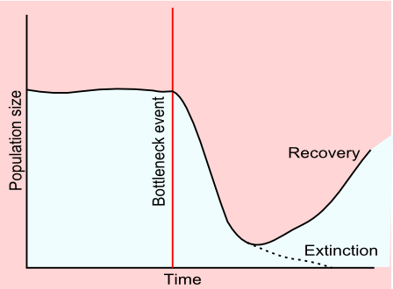
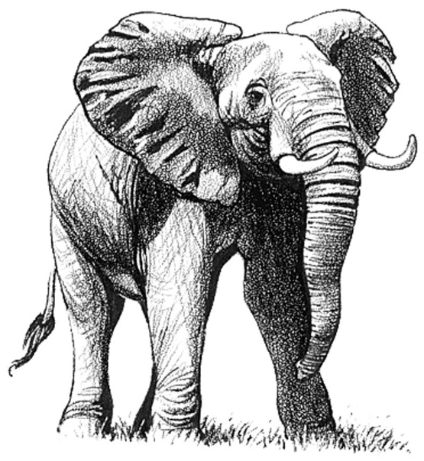
Genetic drift & Bottlenecks
Bottleneck
  A drastic reduction in population size brought about by severe pressure (events like natural disasters)
  After a bottleneck, genetic drift is pronounced when a few individuals rebuild a population, fumbling to figure out beneficial traits.
  Example: African Elephants from homework.
  Example: The Great Dinosaur Extinction.
Original
Population
Catastrophic
Event
New
Population
Dynamics
A
B
A
B
A
B
A
A
A
B
A
B
A
A
B
B
A
B
B
A
B
A
B
B
B
A
C
A
C
A
A
C
A
C
A
A
B
A

Slide 19
Genetic drift & The Founder Effect
Founder effect
  Genetic drift is pronounced when a few individuals start a new population.
  (Often in conjunction with bottlenecks)

Slide 20
3. Mutation Revisited
Mutations are the source of new alleles that give rise to differences in details of shared traits
  Lethal mutations usually result in death
    Decrease fitness but these rarely survive the gene pool.
  Neutral mutations have no effect on survival or reproduction
    Often considered “silent” mutations.
    In humans, the average person undergoes 50-100 mutations in their lifetime.
    Less than 3% have any consequence.
    Remember, ~95% of our genome is “junk” DNA
  Beneficial mutations convey an advantage.
    Rare but does occur… has to.

Slide 21
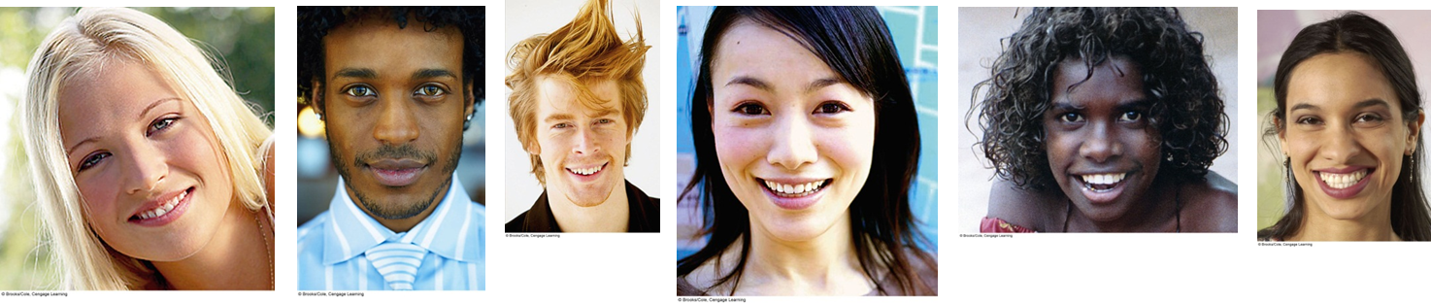
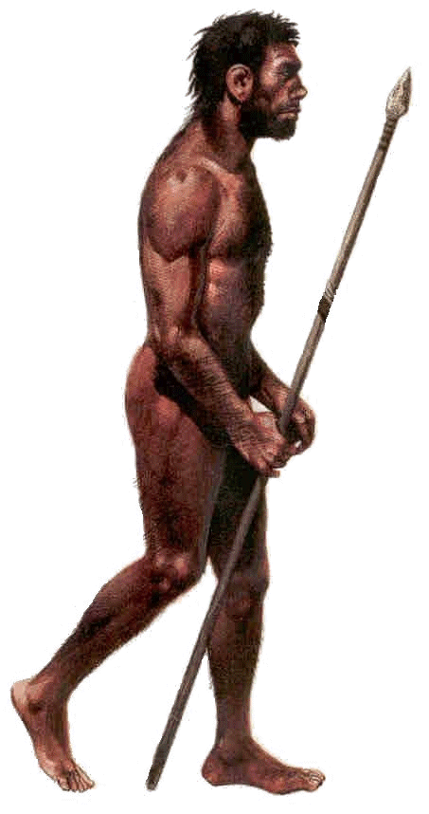

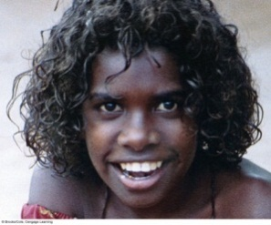
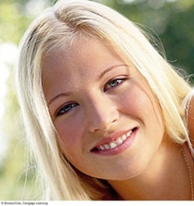



Variation within a species is caused by mutations.
Mutations
Mutations
Mutations
Mutations
Mutations
Mutations

Slide 22
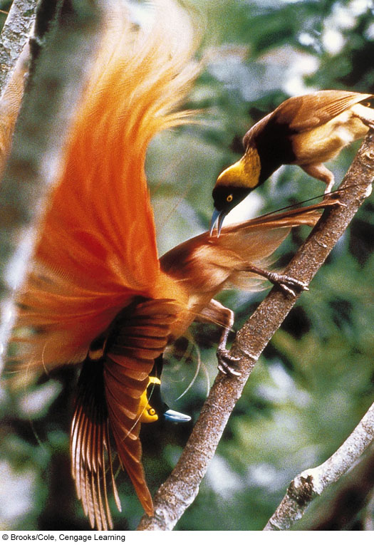
4. Non-Random Mating = Sexual Selection
Sexual Selection is a type of natural selection that increases the chances of reproduction for individuals displaying favorable characteristics.
Mates being picky.
Illustrated in nature by the opposite sex selecting one mate over another.
This hones certain traits and drives evolution.

Slide 23
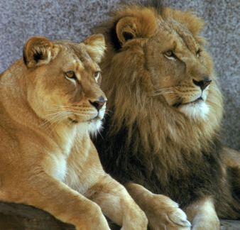
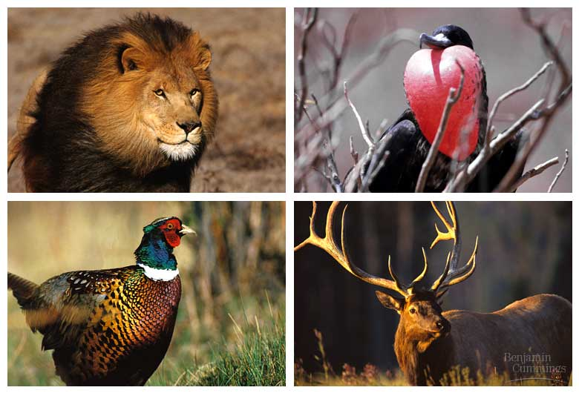
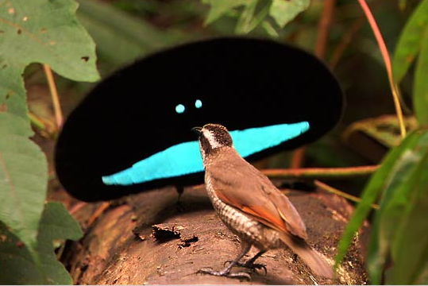
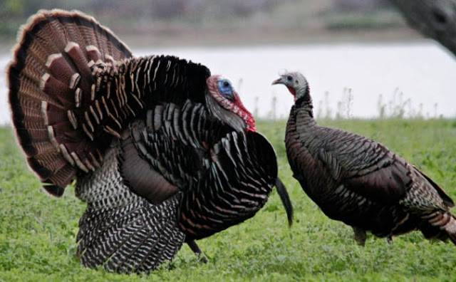
Sexual selection
    sexual dimorphism = the differences between males & females in a species.

Slide 24
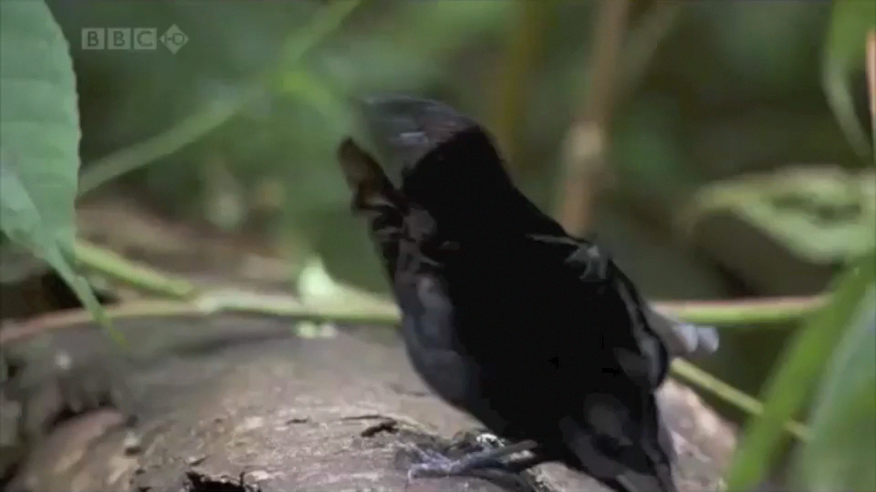
Mating Dance of Bird of Paradise
http://youtu.be/nS1tEnfkk6M

Slide 25
5. Natural Selection…Revisited
Natural selection
  The variable survival and reproduction among individuals of a population that vary in details of their shared traits.
  This is a driving force of evolution.
  Occurs in recognizable patterns depending on the organisms and their environment.

Slide 26
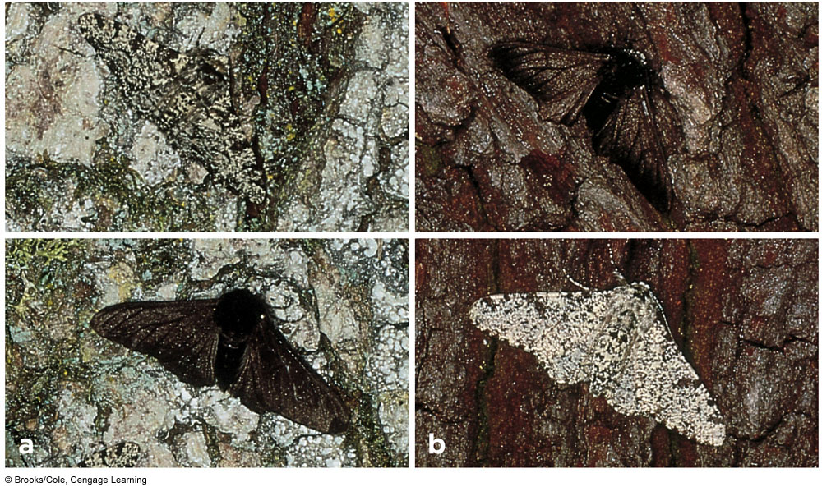
Predation and Peppered Moths
Light color is adaptive in areas of low pollution;
Dark color is adaptive in areas of high pollution

Slide 27
Natural Selection Revisited
Natural Selection supports the best traits
Natural Selection can be limited.
  Indirect Force:
    Natural selection doesn’t act on alleles, only traits.
  Role of Mutation;
    Mutations are often undetectable.

Slide 28
II. How We Know:
Individuals Don’t Evolve, Populations Do
Evolution can only happen because of the Tenets.
Evolution proceeds because of the mechanisms.
Other than knowing this, you need to know that individuals can’t evolve, only acclimate (which is a genetic trait already) or accommodate.
Populations evolve over long periods of time.

Slide 29
II. How to detect evolution: Variation can be calculated
How can evolution be detected?
The answer is in studying the traits and the alleles that cause them.
In science, evolution is ultimately proven by the change in allele percentages over time.
  If we know the genetics of the original species we can compare that to the current species. If there is a change then evolution has occurred.
This is the hard evidence that evolution happens.

Slide 30
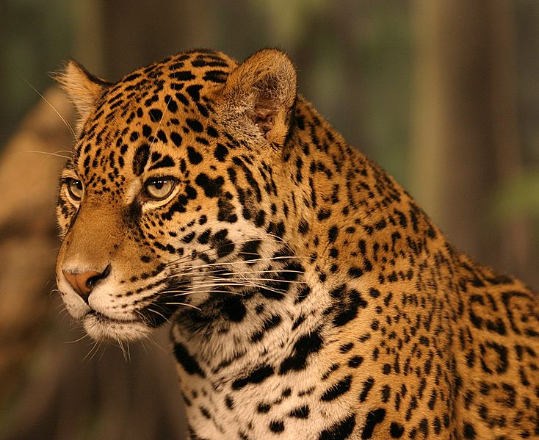
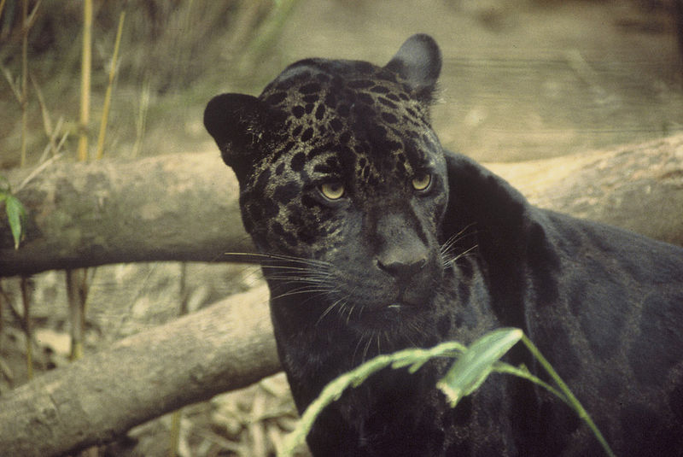
The Gene Pool
The variation is founded in alleles
Alleles
  Different forms of the same gene
  Determines genotype and phenotype
Gene pool
  All alleles found in one population
Within the gene pool, variation is due to various alleles.
Mutations are responsible for the various alleles.
We study the changes in alleles over time in a gene pool.
The dominant phenotype
The Black Jaguar
6% of the South American population

Slide 31
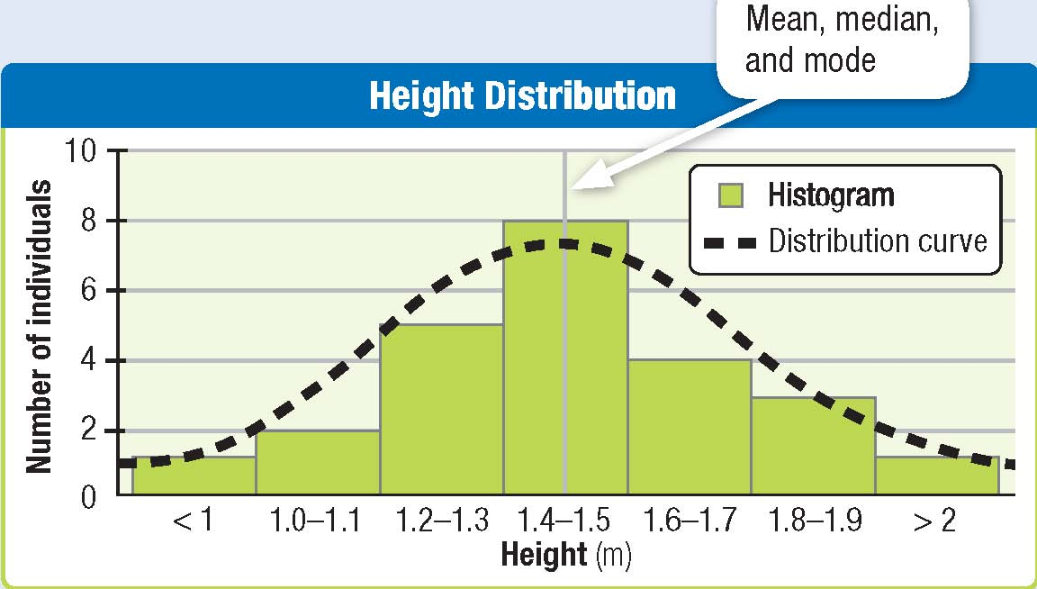

1st: Normal Distribution
Mean = average
Median = middle value
Mode = the number most repeated
“Normal”
Very short
Very tall

Slide 32
3rd: Calculate the Changes
Year 1
Year 1000
30%
BB
25%
bb
50%
bb
55%
BB
20%
Bb
20%
Bb
If we could calculate the changes in alleles we could prove evolution.

Slide 33
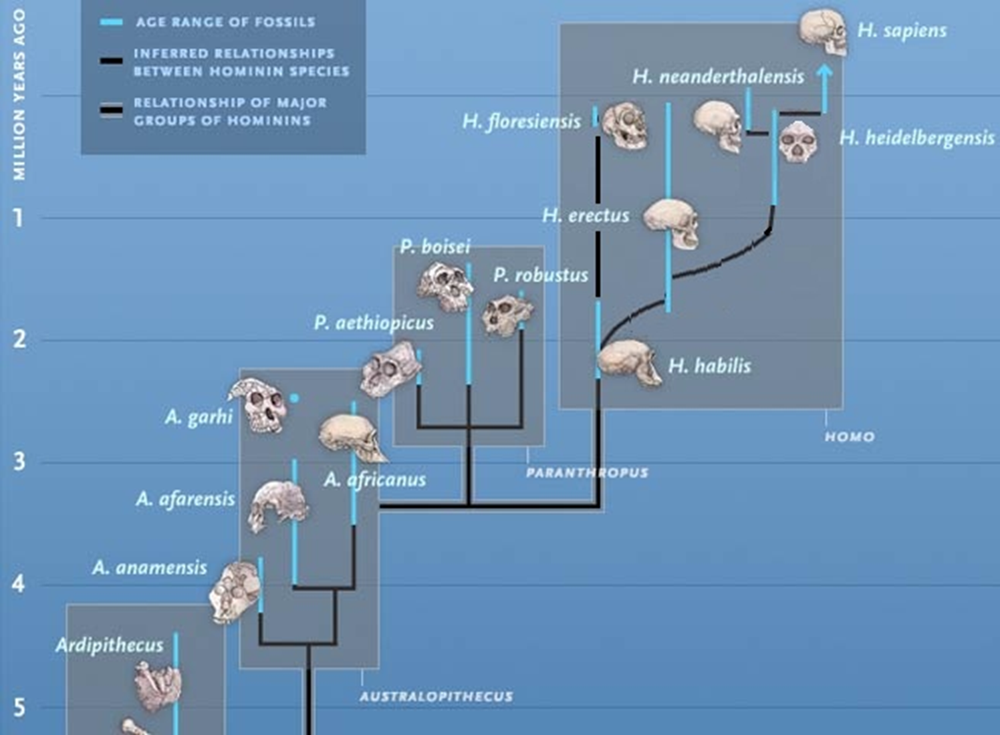
VI. Speciation
Once Genetic Drift Ends…

Slide 34
So we’ve discussed the mechanisms that cause Evolution
Once gene flow ends, reproductive isolation occurs.
Reproductive isolation is when one population no longer breeds with another.
Once reproductive isolation occurs, speciation soon follows

Slide 35
Reproductive Isolation
Speciation
  Evolutionary process by which new species form
  A species is the largest group of organisms capable of interbreeding and producing fertile offspring
  Reproductive isolating mechanisms are always part of the process
When populations become reproductively isolated, divergence follows allowing for natural selection to push the new populations into different species.

Slide 36

Divergence & Speciation
SPECIATION: The formation of new species from a common ancestor.
Microevolution

Slide 37
Reproductive Isolating Mechanisms
Reproductive isolating mechanisms prevent interbreeding among groups.
  Heritable aspects of body form, function, or behavior that arise as populations diverge… they start to change because of the different selection pressures of the different ecosystem and the traits available the founding population.
What are isolating mechanisms?
  Mechanical
  Behavioral/temporal
  Hybridization
  Geographic
    Allopatric
    Parapatric
    Sympatric/ Polyploidy (genetic)

Slide 38
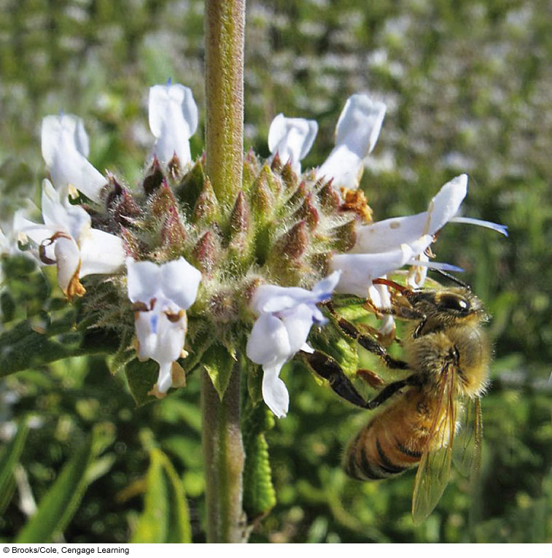
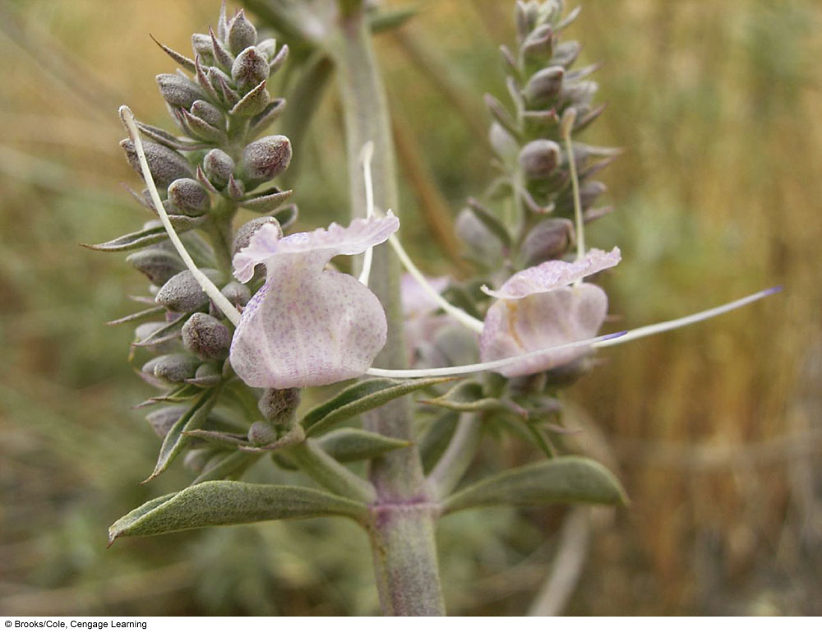
1. Mechanical Isolation
Being built to fit the environment in better ways than competitors.

Slide 39
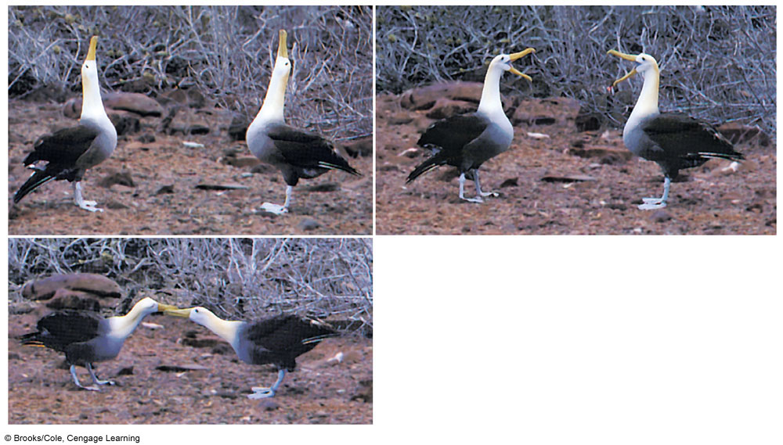
2. Behavioral Isolation
Ex. Behaving in ways only others prefer will give it an advantage in finding a mate.

Slide 40
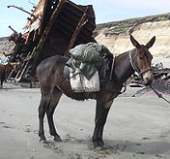
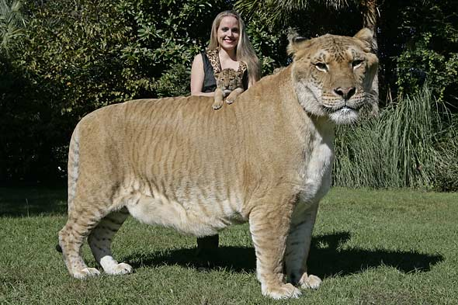
3. Hybridization
The crossing of 2 similar species.
Reduced hybrid viability (ligers, tigons)
  Extra or missing genes
Reduced hybrid fertility (mules)
  Robust but sterile offspring
Hybrid breakdown
  Lower fitness with successive generations

Slide 41
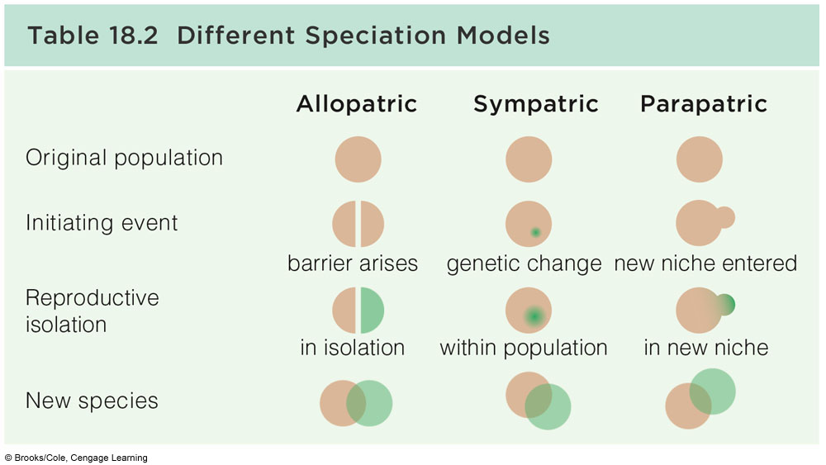
4 Other Speciation Models

Slide 42
4. Geographic Isolation
1. “Allopatric speciation”
  A physical barrier arises and ends gene flow between populations
  Genetic divergence results in speciation
  Example: llamas, vicunas, and camels
  Example: emu, ostrich, rhea
  Example: flies in Hawaii
  Lots of others, humans to an extent.

Slide 43
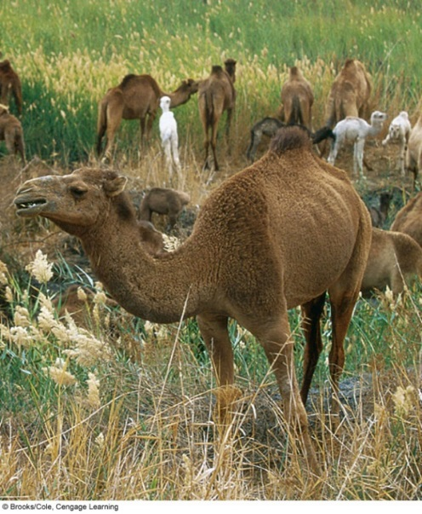
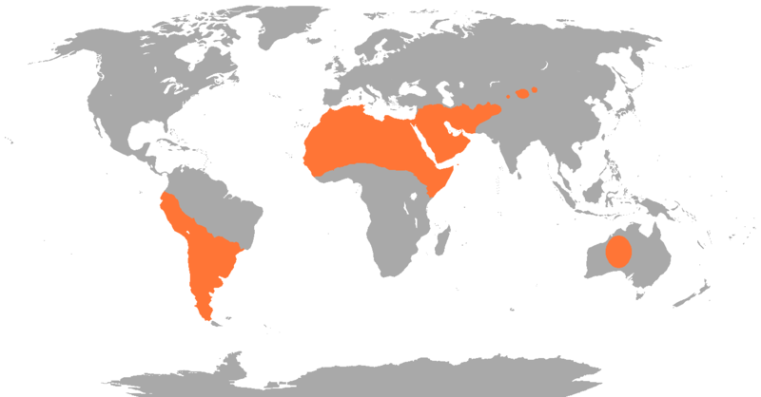
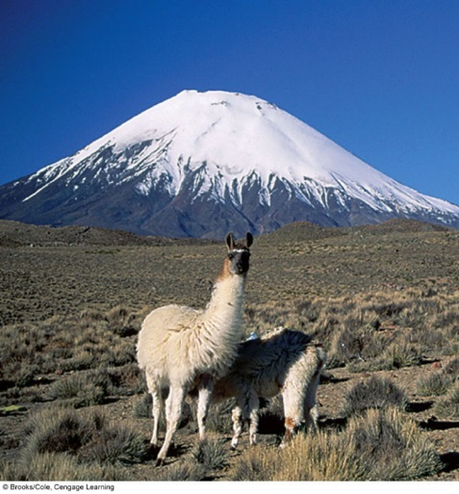
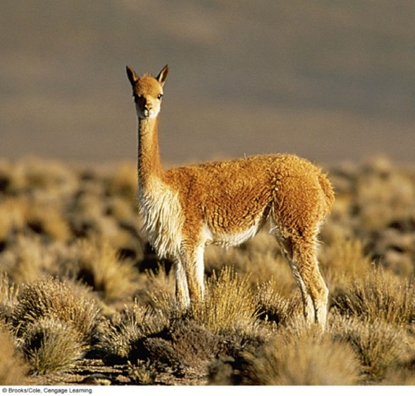
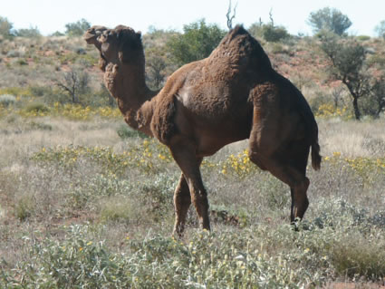
Allopatric Speciation

Slide 44
4. Geographic Isolation
2. Parapatric speciation, populations in contact along a common border evolve into distinct species
Hybrids in the contact zone are less fit than individuals on either side

Slide 45
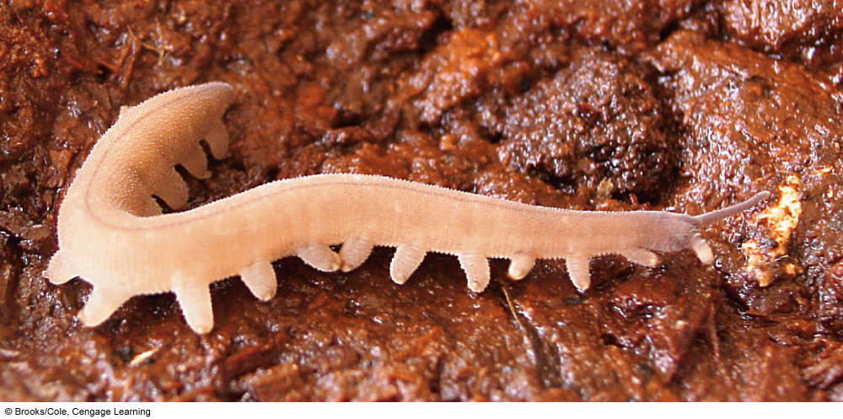
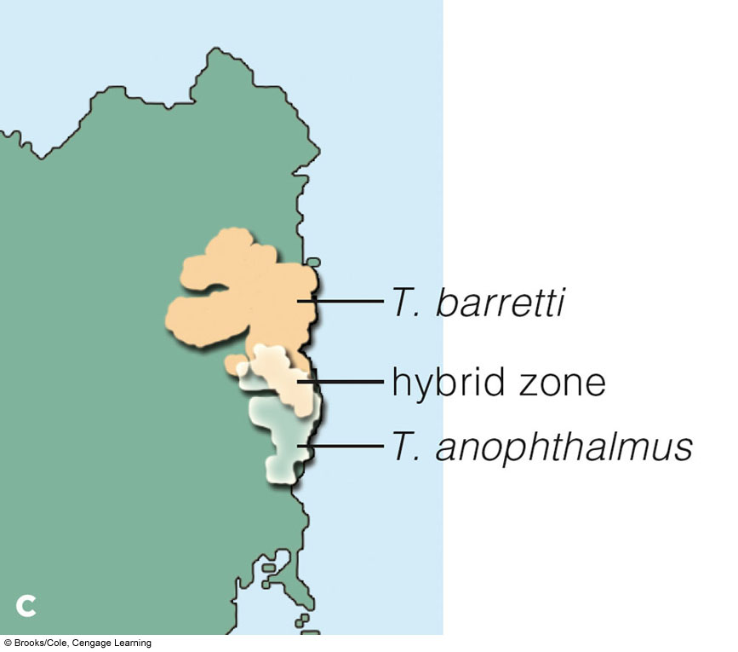
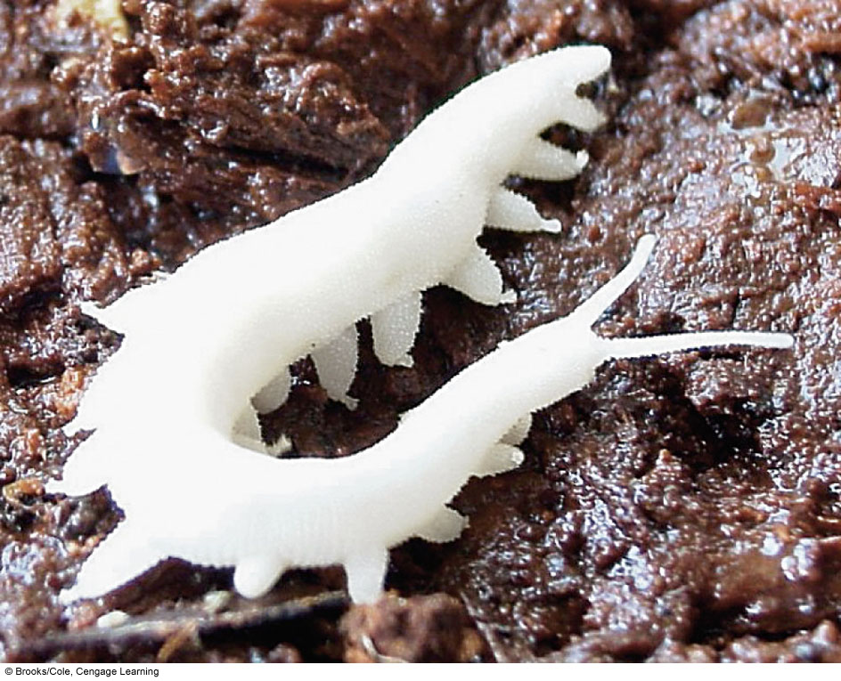
Parapatric Speciation

Slide 46
5. Genetic Isolation within region
Sympatric speciation, new species form within a home range of an existing species, in the absence of a physical barrier
  Polyploidy An example when there is a change in chromosome number that can cause instant speciation .
  On Lord Howe Island, species of palms are reproductively isolated because of polyploidy

Slide 47
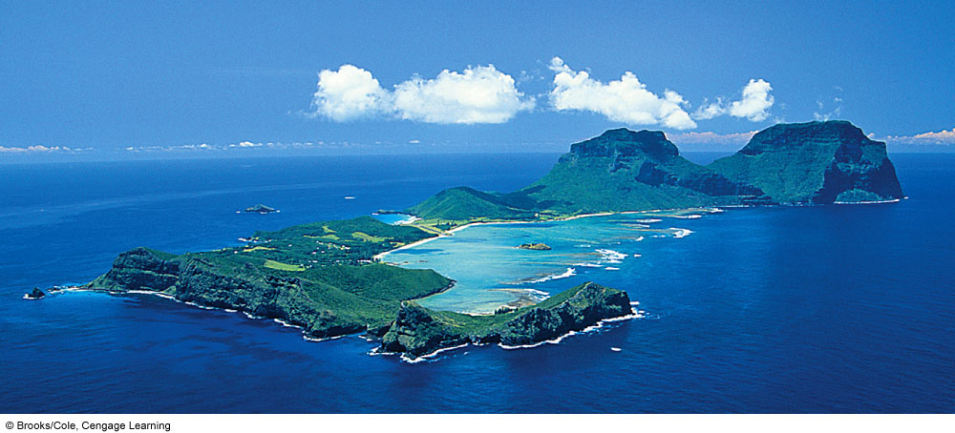


Sympatric Speciation in Palms

Slide 48
Vii. Macroevolution
Macroevolution
  Large-scale patterns of evolutionary change
  Includes patterns of change such as one species giving rise to multiple species, the origin of major groups, and major extinction events
Coevolution
Adaptive radiation
Key innovation

Slide 49
Macroevolution…The Patterns of Evolution
Patterns of Macroevolution: that affect species.
Co-evolution: Organisms are part of one other’s environment, so they can affect one another’s evolution. Species that live in close contact often have clear adaptations to one another’s existence.
Adaptive Radiation: Over time, species may split into two or more lines of descendants, or lineages. As this splitting repeats, one species can give rise to many new species. The process tends to speed up when a new species enters an environment that contains few other species (meaning less competition). Helps explain finches.

Slide 50
Coevolution
Two species in close ecological contact act as agents of selection on each other (coevolution)
  Predator and prey
  Host and parasite
  Pollinator and flower
Over time, the two species may come to depend on each other.

Slide 51

Coevolution
Hawk moth & Orchid
Coevolved species. The orchid Angraecum sesquipedale, discovered in Madagascar in 1852, stores its nectar at the base of a floral tube 30-centimeters (12 inches) long. Charles Darwin predicted that someone would eventually discover an insect in Madagascar with a proboscis long enough to reach the nectar and pollinate the flower. Decades later, the hawkmoth Xanthopan morgani praedicta was discovered in Madagascar. Its proboscis is 30–35 cm long.
proboscis
nectar tube
10 cm
Fig. 18-25, p. 296
Notes:
Figure 18.25

Slide 52

Bee & the orchid

Slide 53

Ecological niches
A niche is the entire collective habitat where a population lives.
When populations inhabit different niches, divergence often follows…because there are different selection pressures.
Adaptive radiation
A burst of speciation that occurs when a lineage encounters a new set of niches because of a Key Innovation: A structural or functional adaptation that allows individuals to exploit their habitat in a new way
Again, caused by variation and natural selection
For the finch, it was their beaks.

Slide 54
Patterns of Macroevolution
How Quickly Do Species Evolve?
There are two main schools of thought…
Gradualism
Punctuated Equilibrium

Slide 55
Is evolution Gradual or abrupt?
Gradualism : In Darwin’s day, the idea of slow, gradual change was new to geology as well as biology. Darwin had argued that large scale changes, such as the formation of new species, must require many small changes to build up gradually over a long period of time. This model is called gradualism.

Slide 56
Macroevolution
Gradualism conflicts with another more modern theory that suggests evolution can happen in bursts over a very fast period of time.
Punctuated Equilibrium: Some biologists argue that species do not always evolve gradually. Species may remain stable for long periods until environmental changes drastically and suddenly create new pressures. Then, many new species may “suddenly” appear. This model is called punctuated equilibrium.

Slide 57

Which way is correct?
Probably both but there is a lot of evidence that PE is the more correct.
Gradualism | Punctuated Equilibrium
Small evolutionary changes accumulate over long periods of time. These result from mutations present in alleles present in population. | Catastrophic events, like volcanoes or meteor strikes, suddenly change the environment, creating new selection pressures. The fittest survive.

Slide 58
VII. How does evolution stop?
Eliminated Evolution…
  Stasis
  Extinction

Slide 59

Stasis
Stasis
  A lineage exists for millions of years with little or no change
  Example: Coelacanth has shown up in the fossil record in the same form for millions of years.

Slide 60

Extinction
Extinction
  The irreversible loss of a species from Earth
Mass extinctions
  Extinctions of many lineages, followed by adaptive radiations
  Five catastrophic events recorded in which the majority of species on Earth disappeared
K–T extinction, abbreviation of Cretaceous–Tertiary extinction, a global extinction event responsible for eliminating approximately 80 percent of all species of animals at or very close to the boundary between the Cretaceous and Paleogene periods, about 65.5 million years ago.
http://www.britannica.com/EBchecked/topic/1314796/K-T-extinction

Slide 61
Closure
Questions?
Reflect on what you’ve learned…
Go to the website & download the ppt. to make up anything you missed.

